Slide 1
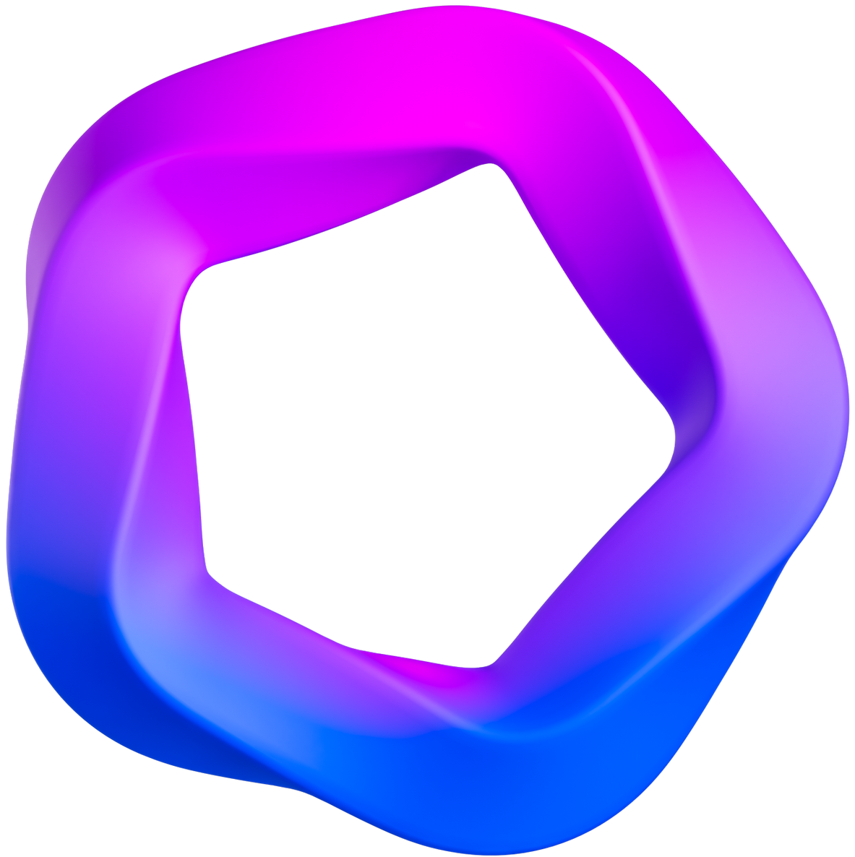

News Website
A Modern Platform for News Consumption and Interaction
Presentated by Uday Chauhan

Slide 2
Introduction
The News Website is a modern MERN-based platform for discovering and interacting with news. It offers secure user authentication, personalized profiles, and a seamless reading experience across devices.
Project Summary
This project delivers a responsive, feature-rich news platform that combines external news sources with advanced user interaction, analytics, and gamification, all built for scalability and ease of use.
Users can bookmark, like, and comment on articles, track their reading history, and view analytics. Gamification and admin tools encourage engagement and make content management easy.

Slide 3

Secure Authentication
01
Robust login and registration with email verification using time-limited codes.
Interactive News Feed
02
Browse, bookmark, like, and comment on articles with personalized reading history.
Key
Features
03
Analytics Dashboard
Track user registrations, article views, likes, and bookmarks by time period.
04
Responsive Design
Optimized for desktop and mobile, with light/dark theme support for all users.

Slide 4




Technologies Used
Frontend
Backend
Cloud & APIs
Dev Tools
React.js, Redux Toolkit, Vite, Tailwind CSS, React Router, Axios
Node.js, Express.js, MongoDB, Mongoose, JWT, bcryptjs
Cloudinary (image storage), News API (articles), SMTP (email)
Nodemon, Git, Postman

Slide 5
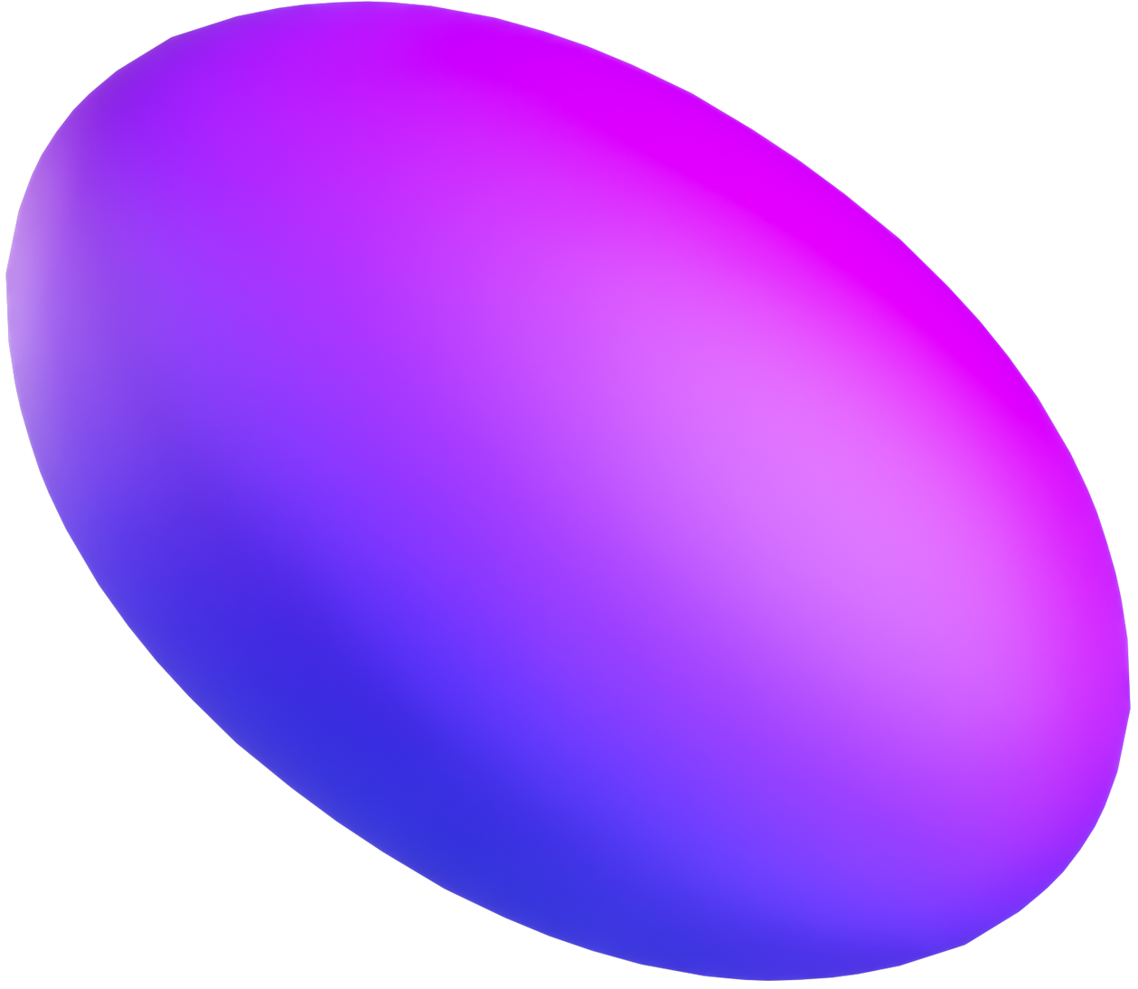
Future Improvements
1
Mobile App Development
Launch native iOS and Android apps for a seamless mobile experience.
2
AI-Powered Recommendations
Integrate machine learning to suggest personalized news articles based on user interests and reading history.
3
Real-Time Push Notifications
Implement push notifications to alert users about breaking news, comments, and platform updates instantly.

Slide 6
Conclusion
Delivers a modern, full-stack solution for interactive news consumption.
Integrates secure authentication, personalized user profiles, and advanced analytics.
Encourages user engagement through gamification and social features.
Provides robust admin tools for content management and platform monitoring.
Built with scalable architecture and best practices for maintainability.
Sets a strong foundation for future enhancements and innovation.

Slide 7


Thank you
Contact Us
Uday Chauhan
+635-133-4613
uday.chauhan0408@gmail.com

